Slide 1
Content Management System Project
Leroy Maswaure 1710240005

Slide 2
Contents
Menus and Widgets.
Elementor Builder, Anti Spam and Security , and Analytics and Seo Mechanisms
Tags and Categories and blocks
Caching with W3 Cache
CSS
Custom Wordpress plugin

Slide 3
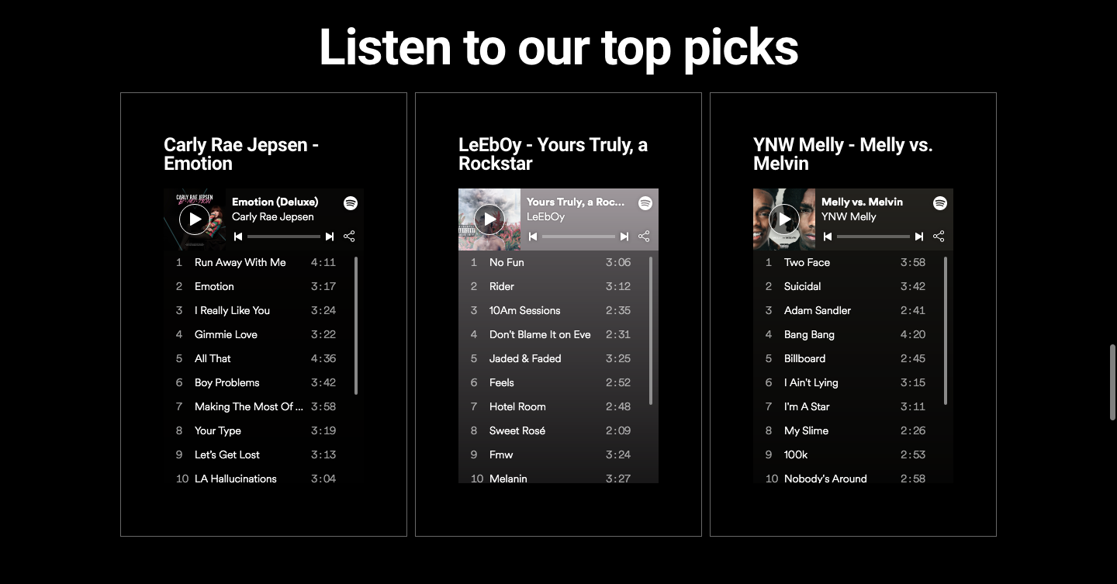
Menus and Widgets
Menu bar
Use of Navbar with multiple menus
Use of Spotify Widgets to play music
Spotify
Widget

Slide 4
Elementor Builder, Anti Spam and Security , and Analytics and Seo Mechanisms
Yoast
SEO
W3
Cache
Google
Analytics
Elementor
builder
The use of Yoast SEO
The use of W3 caching mechanism
The Use of elementor builder
Use of google insights and analytics
Use of clean talk anti spam

Slide 5
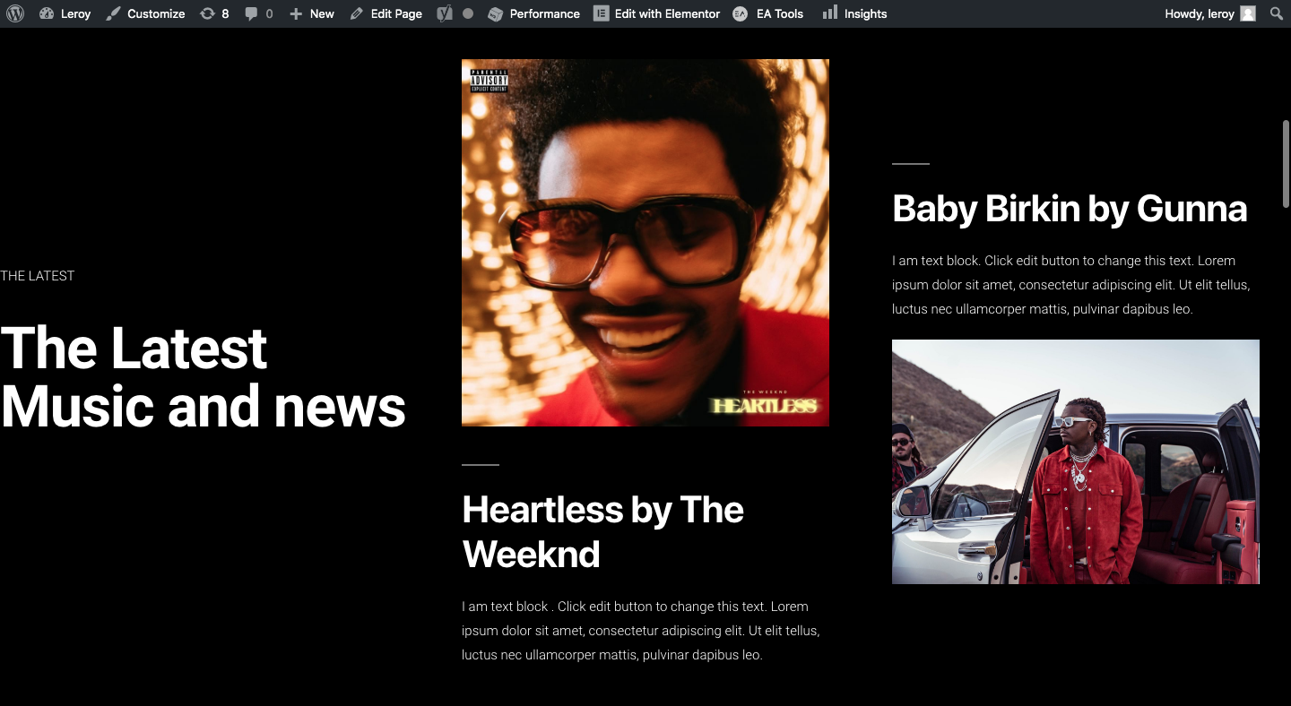
Blocks and Categories
Use of multiple blocks to show I formation and and categories

Slide 6
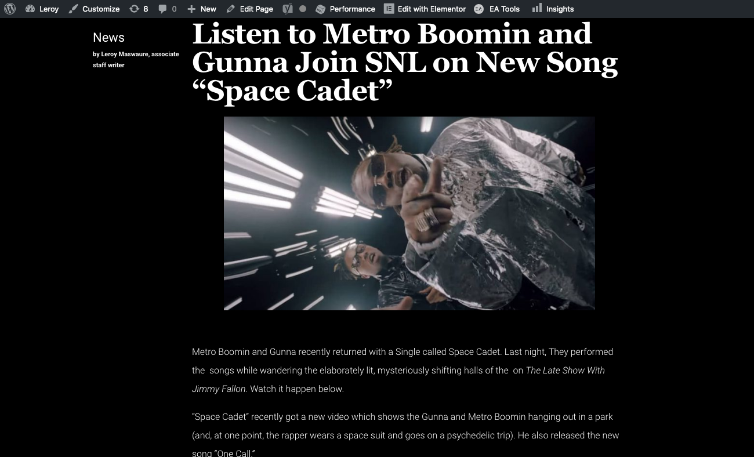
Tags
Tags
Use of tags to show categories of
News writer and common keywords in a
block or paragraph.

Slide 7
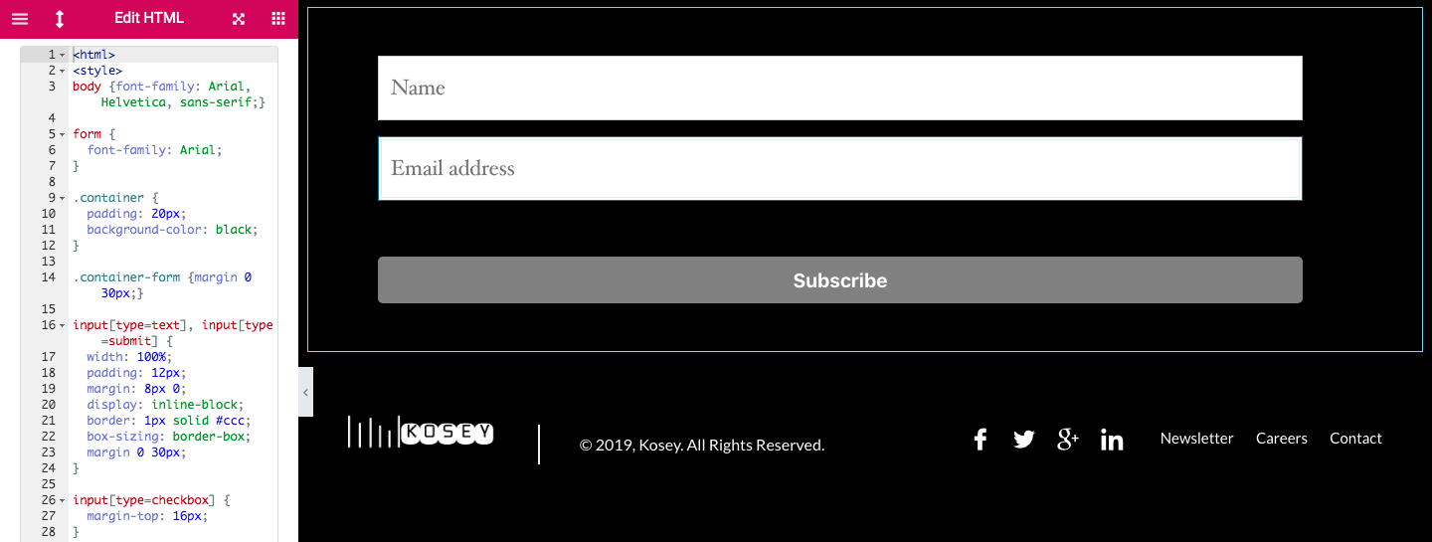
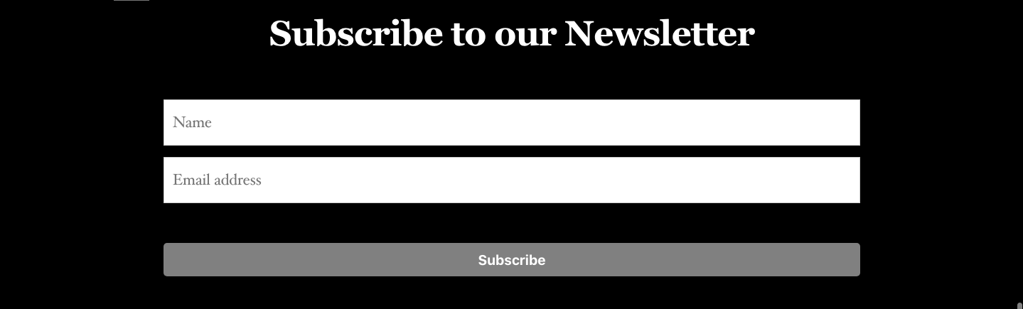
Custom CSS
INLINE CSS CODE
Outcome

Slide 8
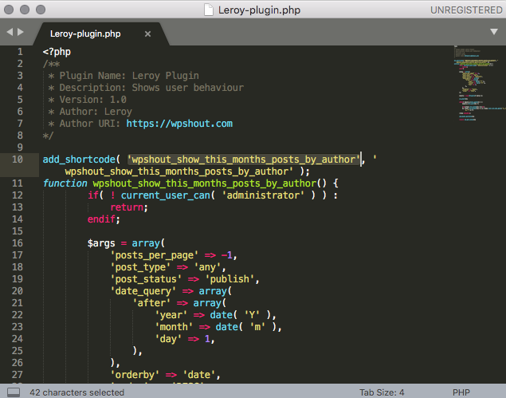
Custom WordPress Plugin Code
Php Code
Creation of custom worpress plugin to show most recent reviews on review page with user name and date

Slide 9

Custom WordPress Plugin Result
Result

Slide 10
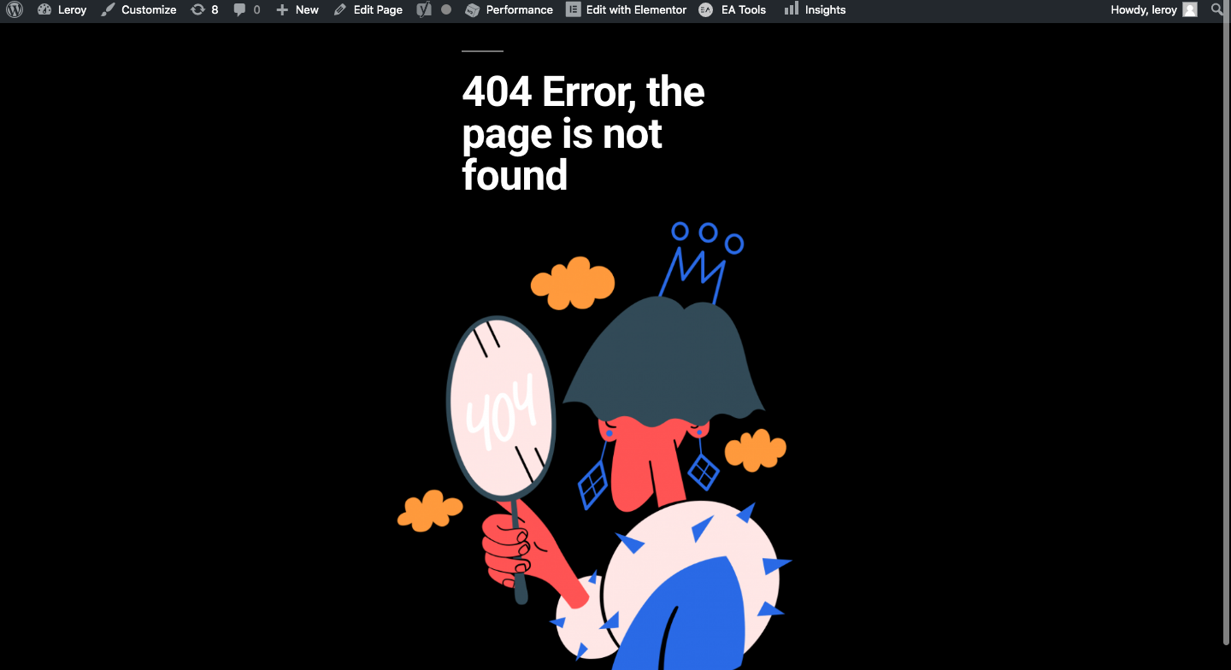
404 Page

